Slide 1
CS621 Project 2021/2022
Olwyn Byrne
Student Number: 21253074
Plan a 10km Race

Slide 2
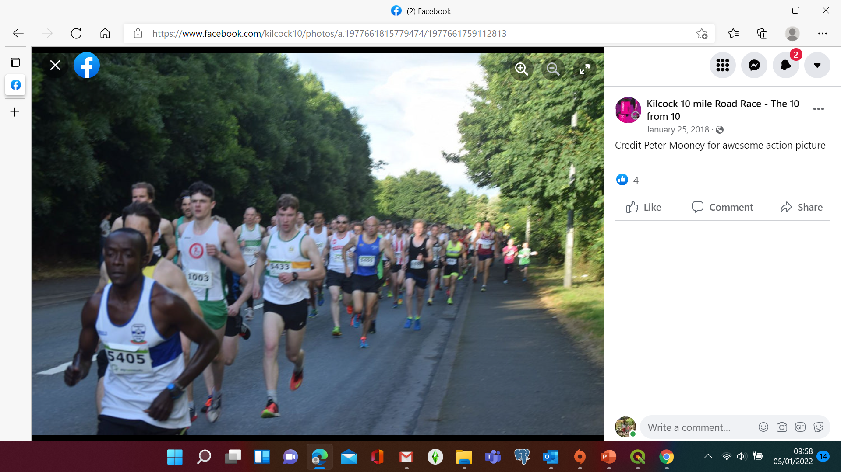
Introduction
Investigate possible routes for a 10km race in Kilcock
Start & end close together
Parking
Hall for number allocation & medal ceremony
Toilet facilities/refreshments
Consider Marshalling/Traffic Calming

Slide 3
Datasets
http://download.geofabrik.de/europe/ireland-and-northern-ireland.html
Shapefiles used:
gis_osm_buildings_a_free_1
gis_osm_pois_a_free_1
gis_osm_roads_free_1
gis_osm_traffic_free_1

Slide 4
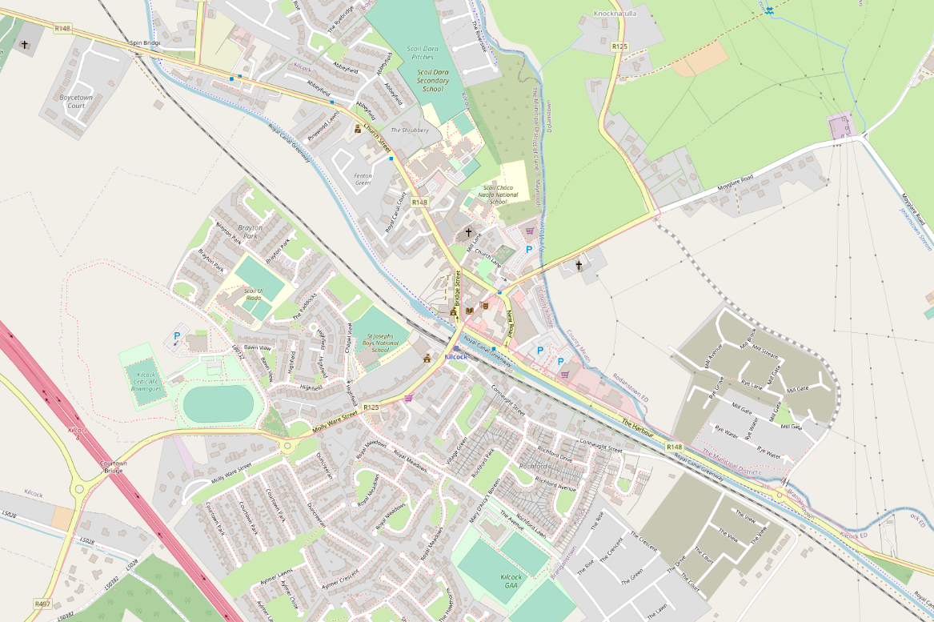
Kilcock

Slide 5
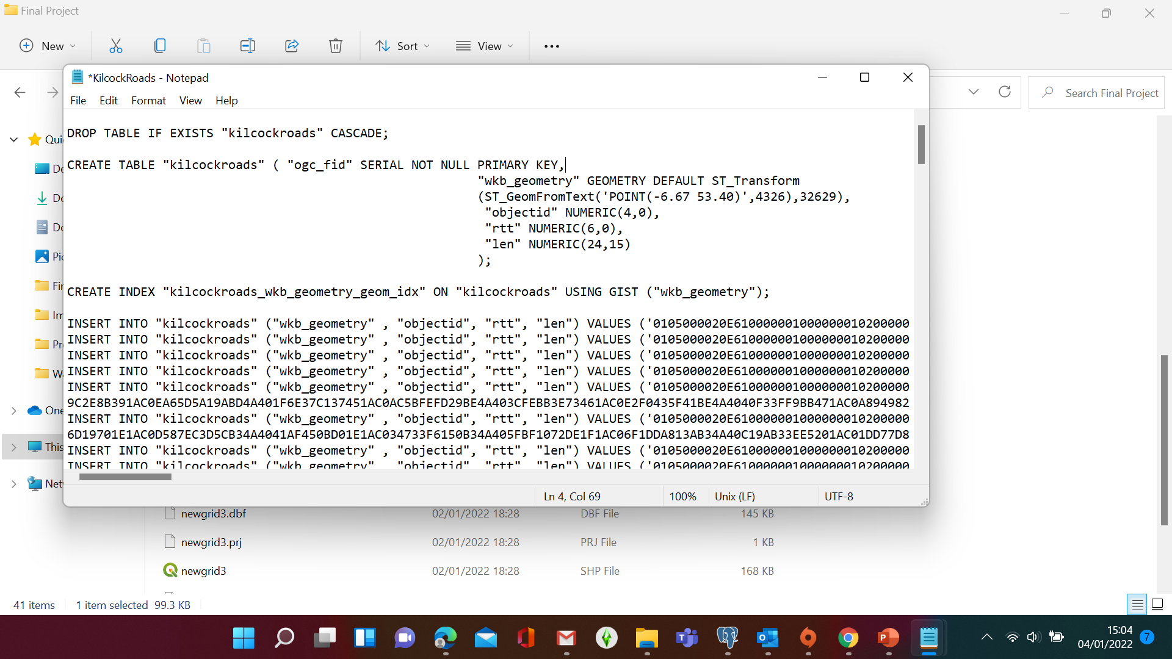
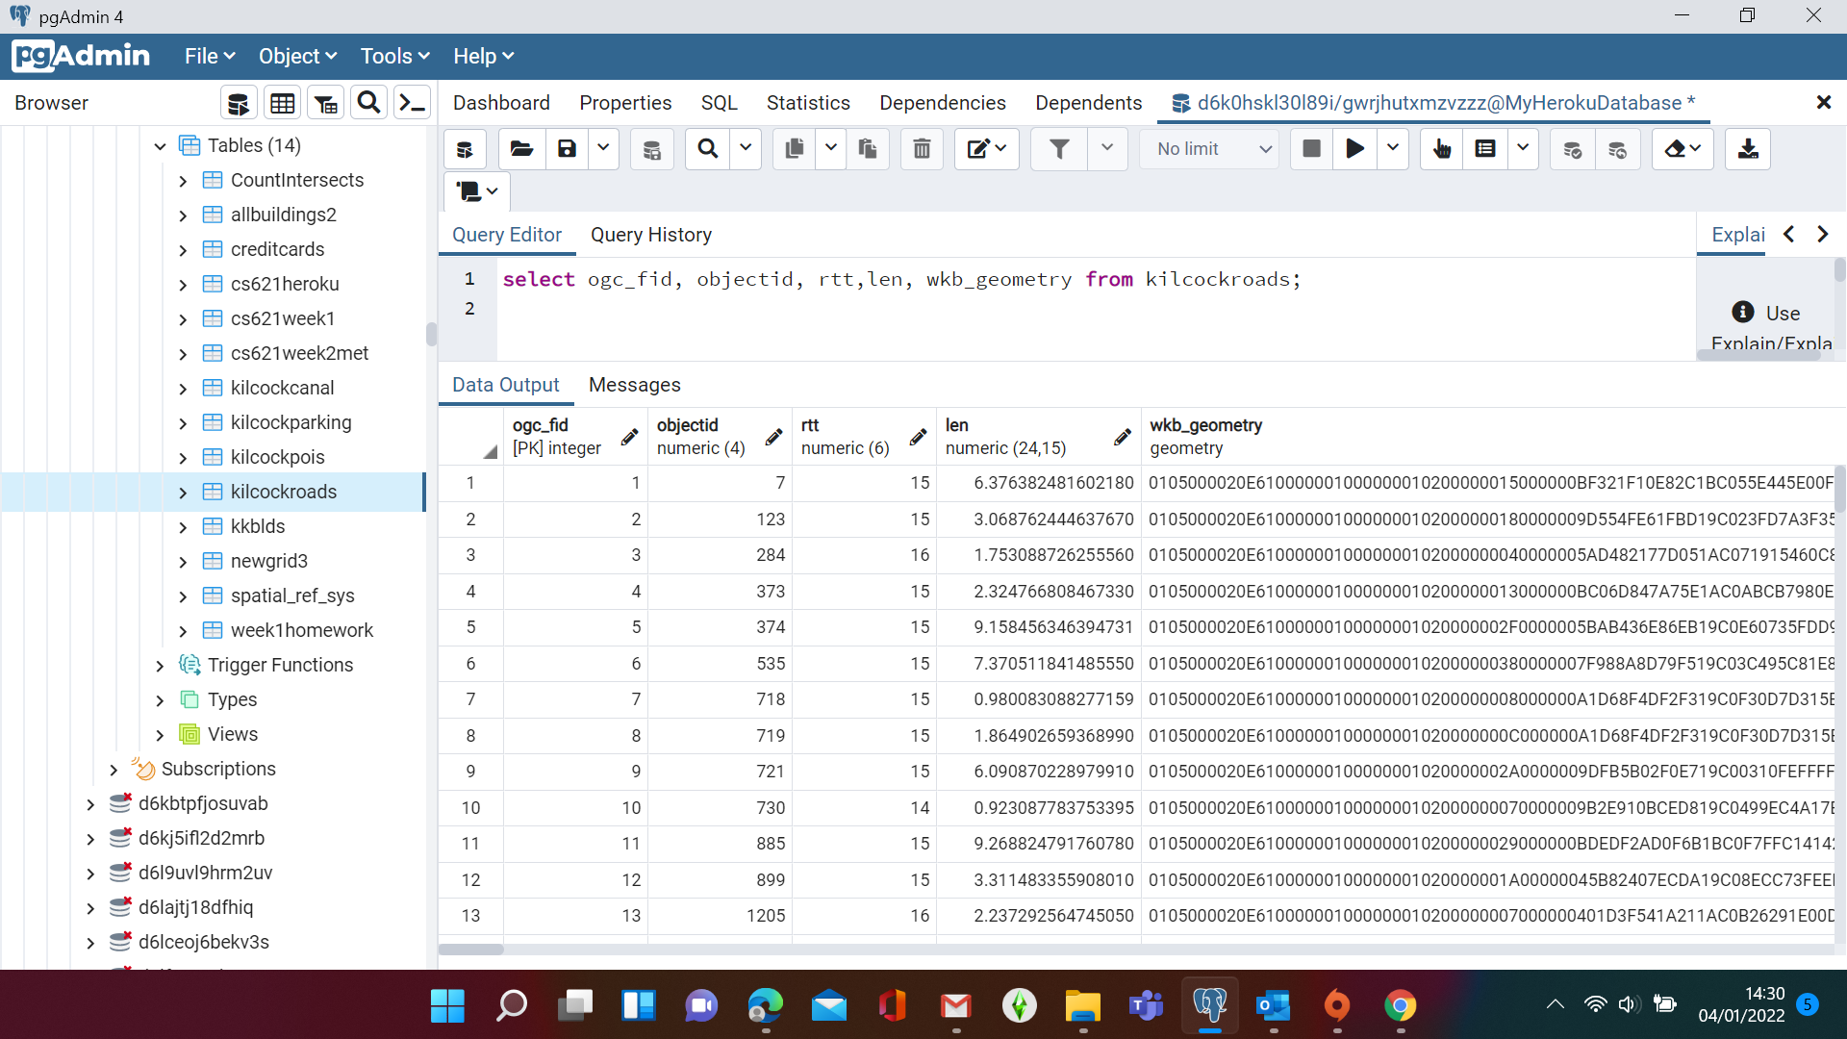
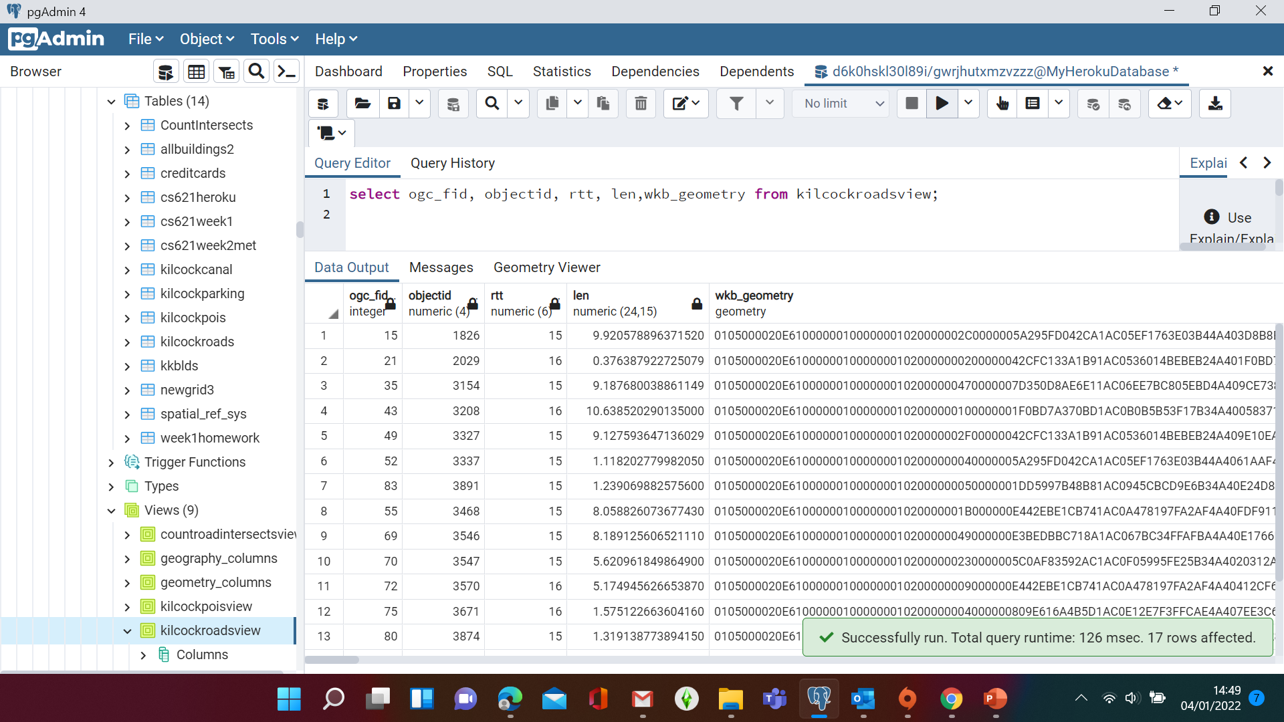
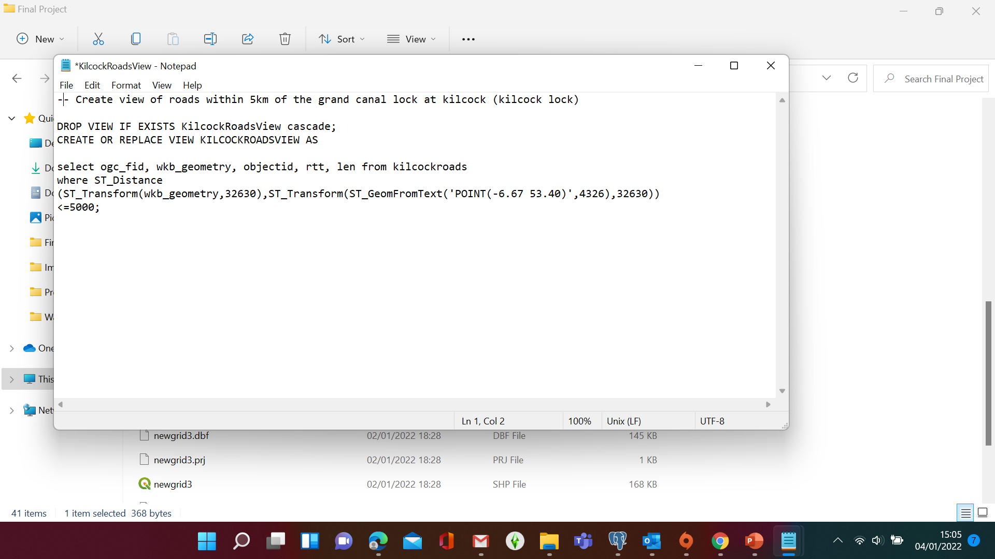
Roads
Kilcockroads Table
KilcockRoadsView

Slide 6
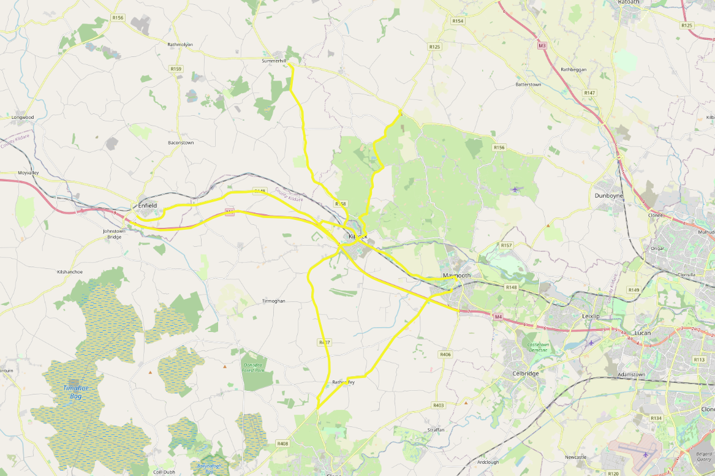
Roads within 5km of Kilcock Centre

Slide 7
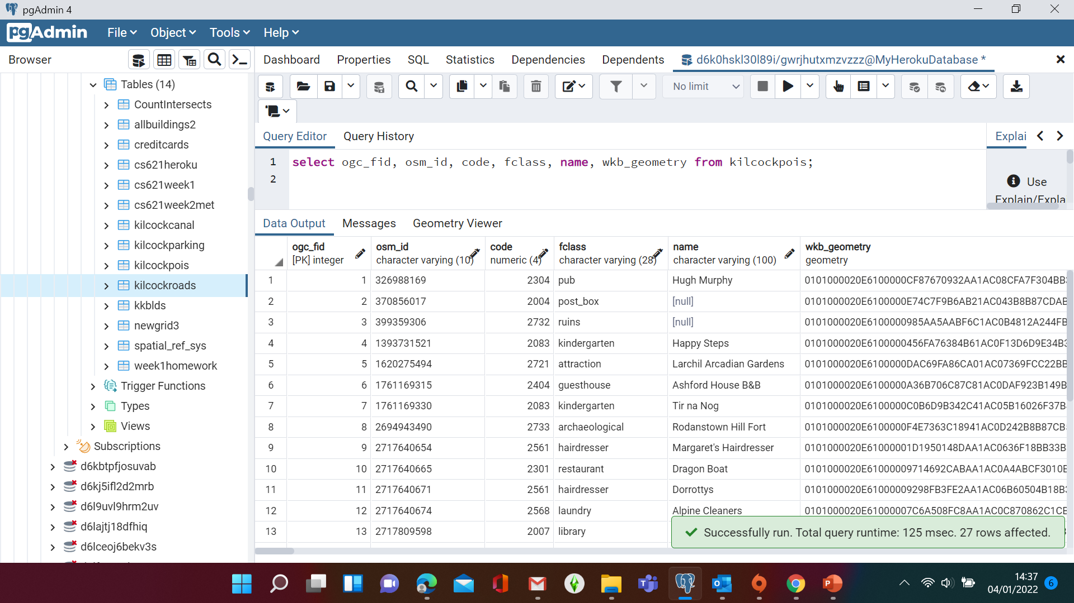
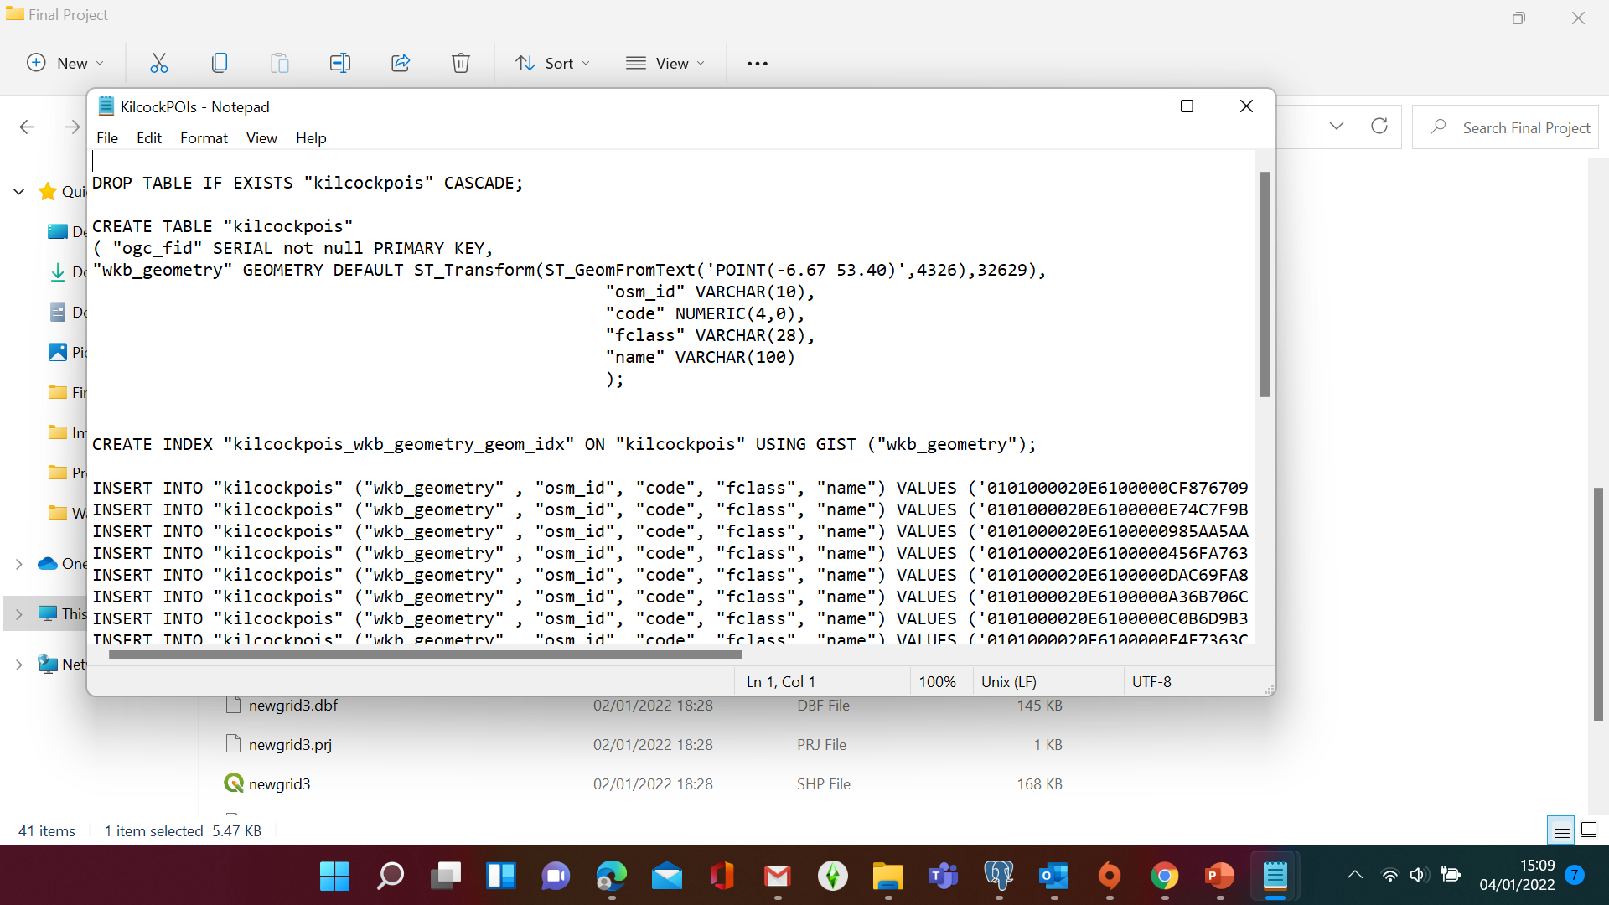
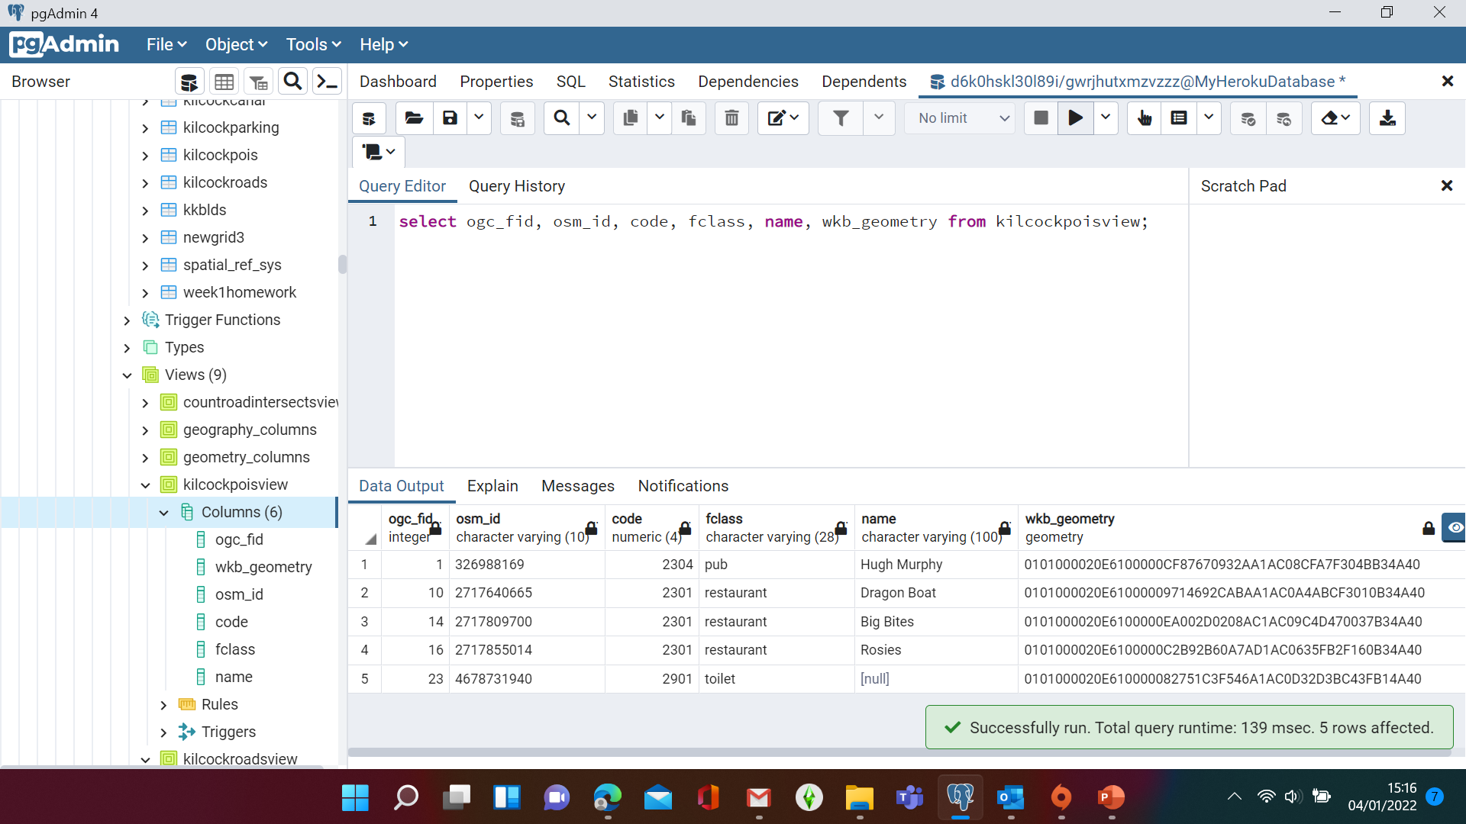
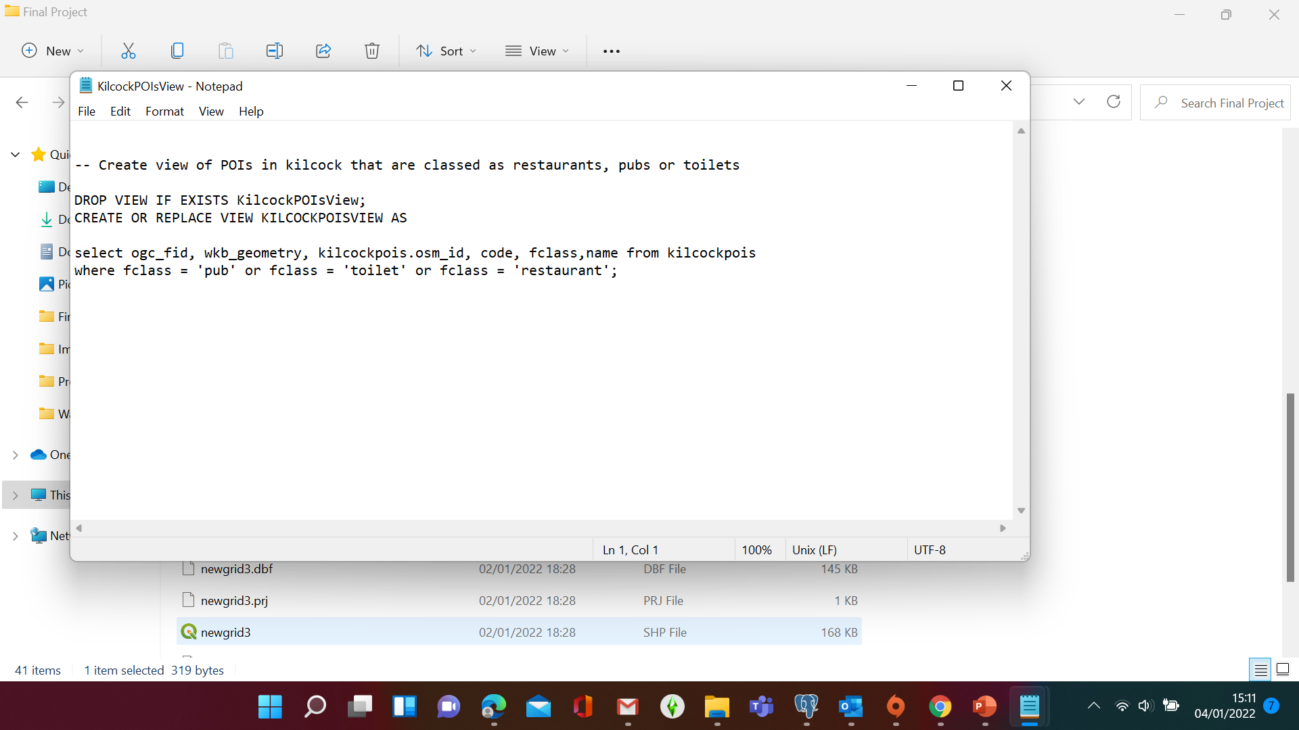
POIs

Slide 8
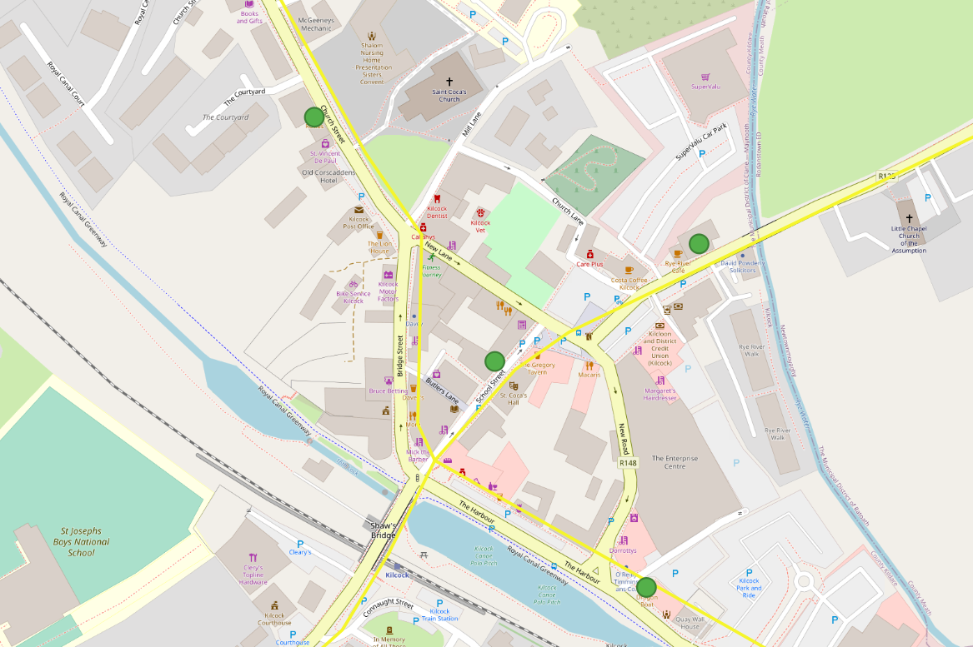
Refreshment & Toilet Facilities

Slide 9
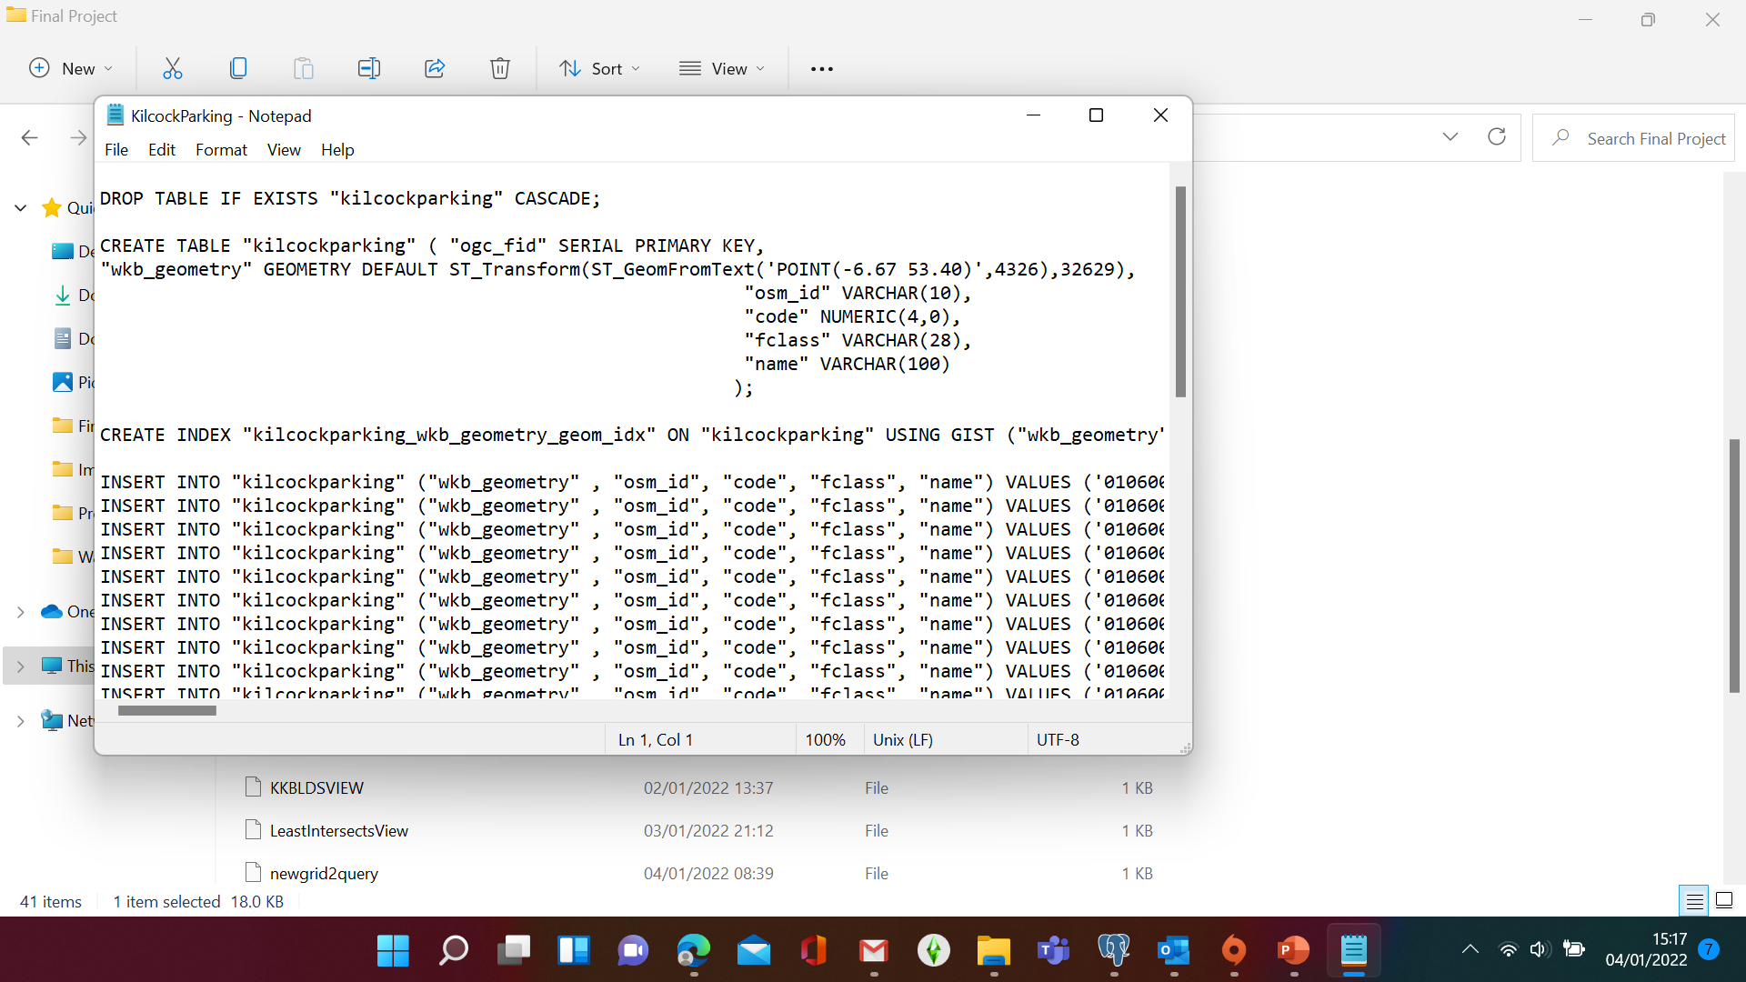
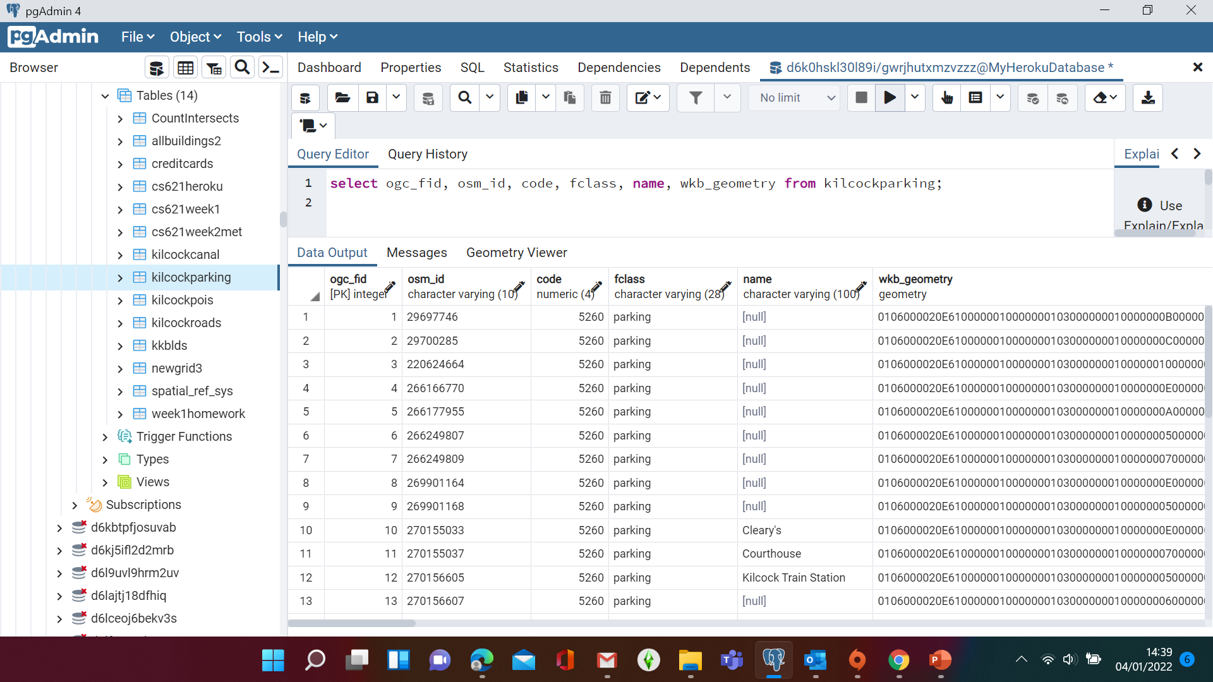
Parking

Slide 10
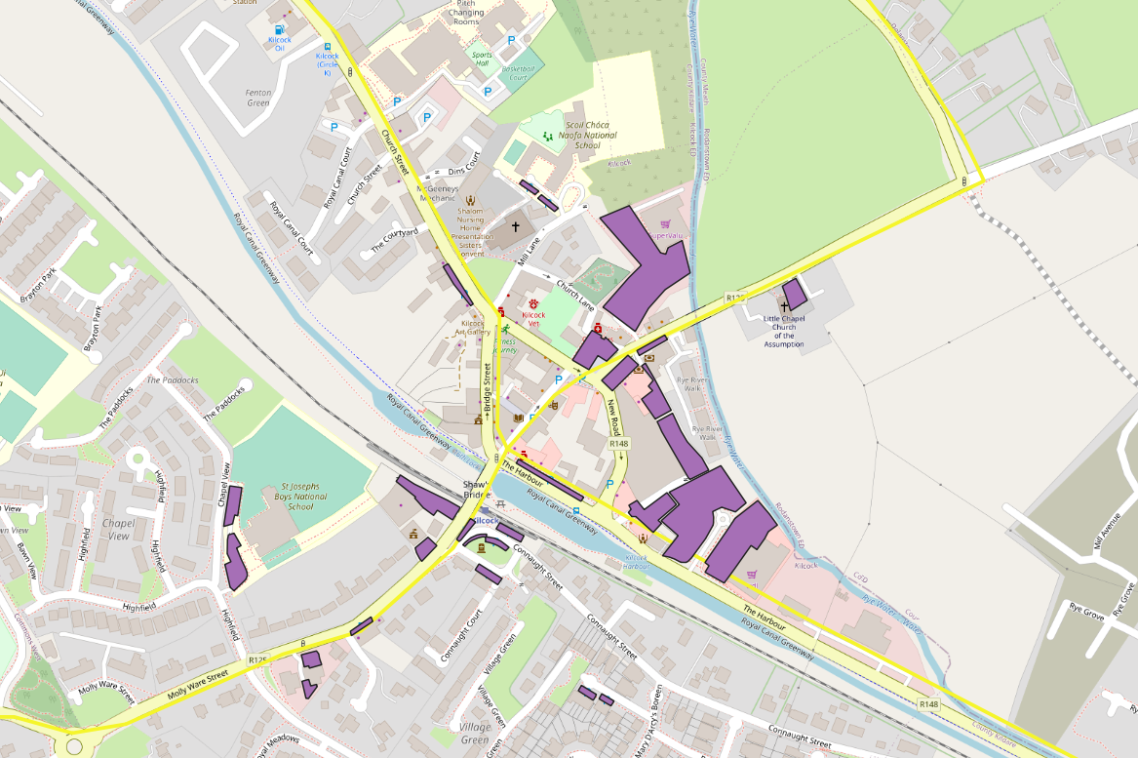
Parking

Slide 11
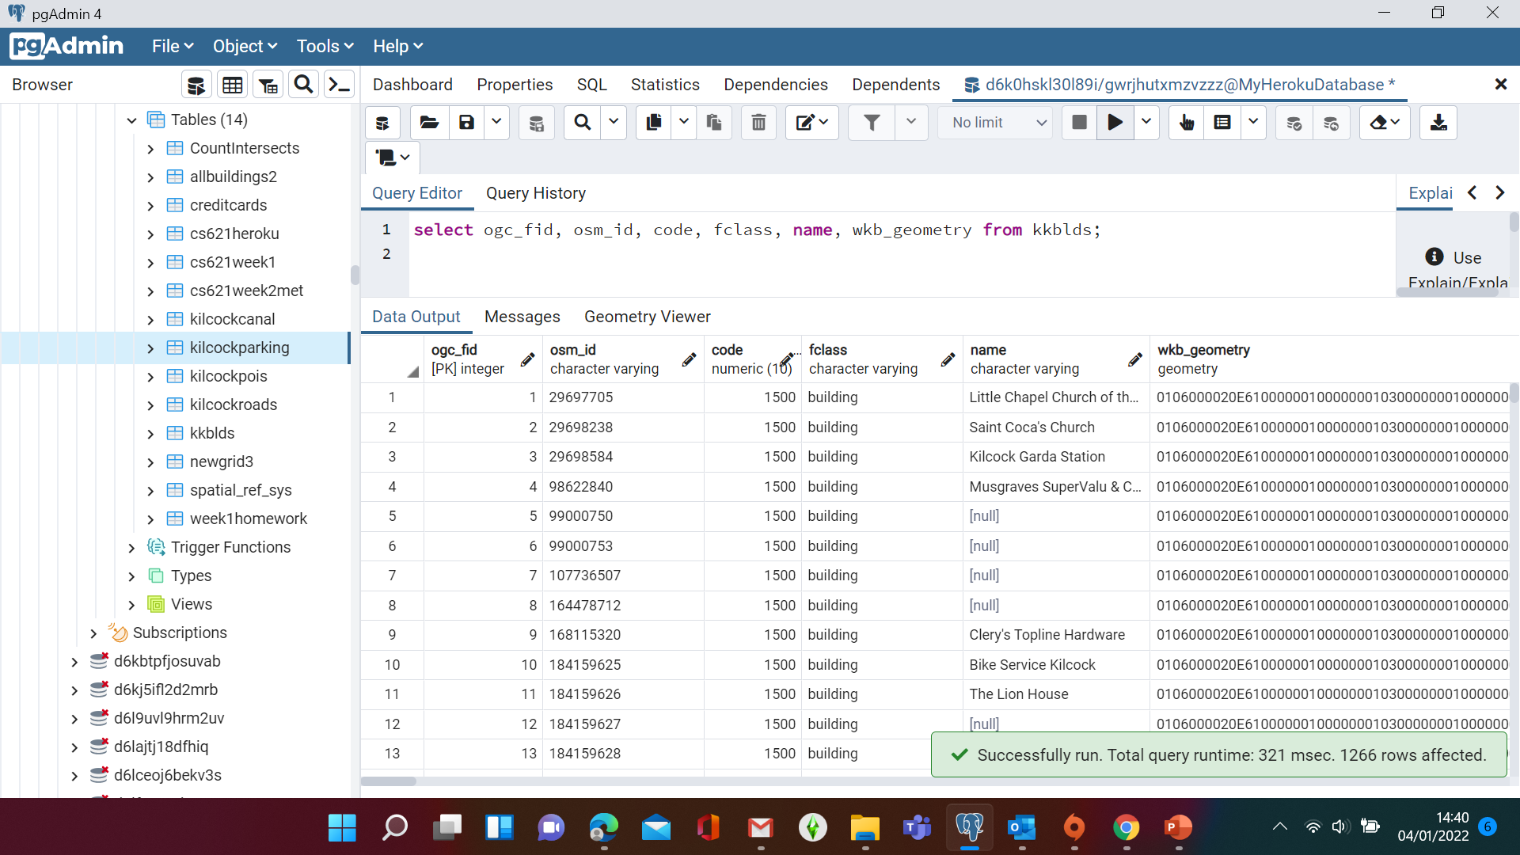
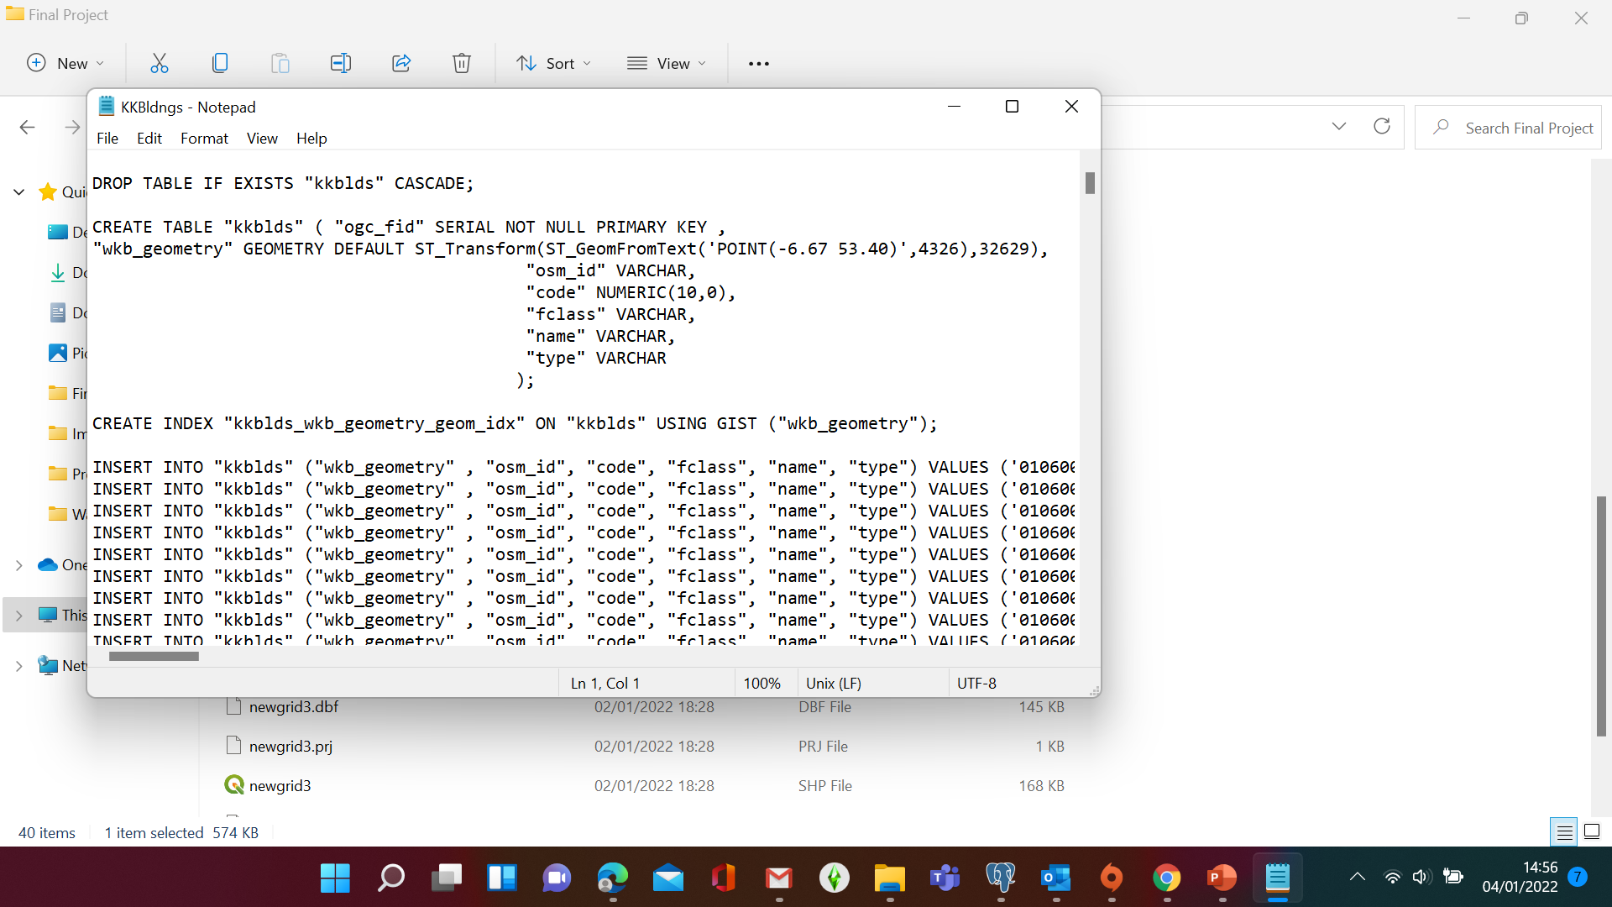
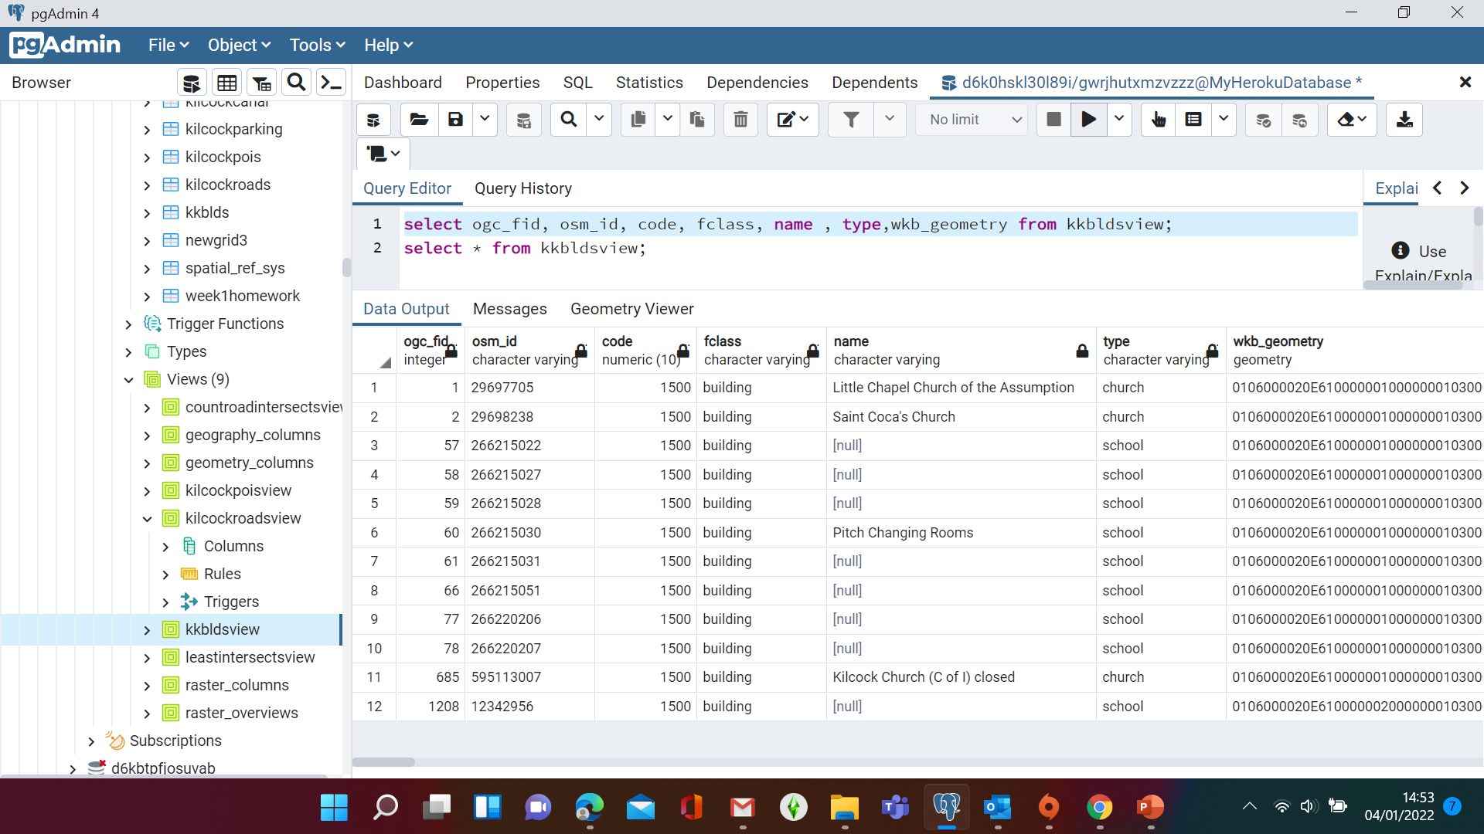
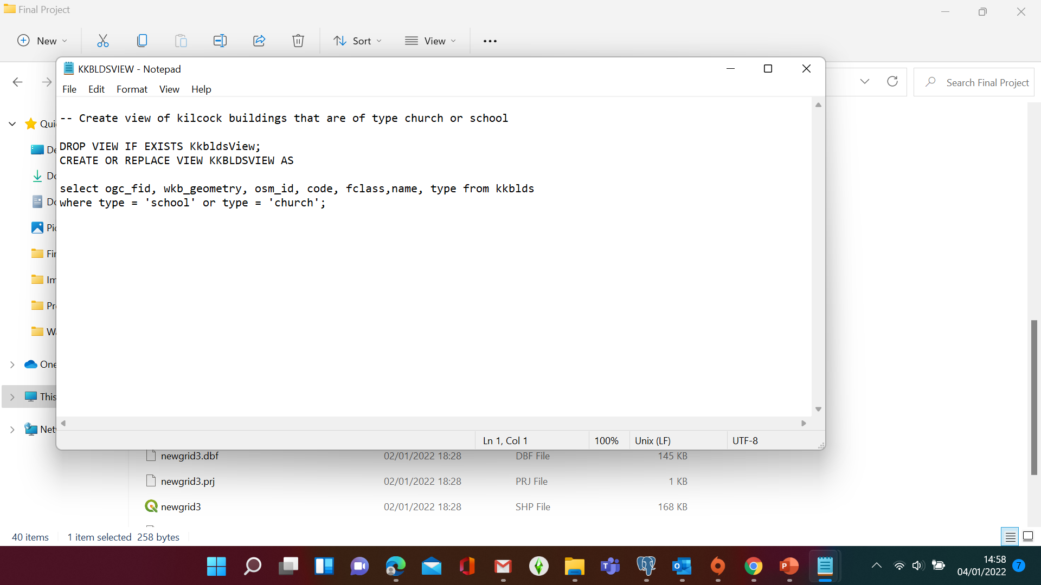
Kkblds Table
Churches & Schools
kkbldsView

Slide 12
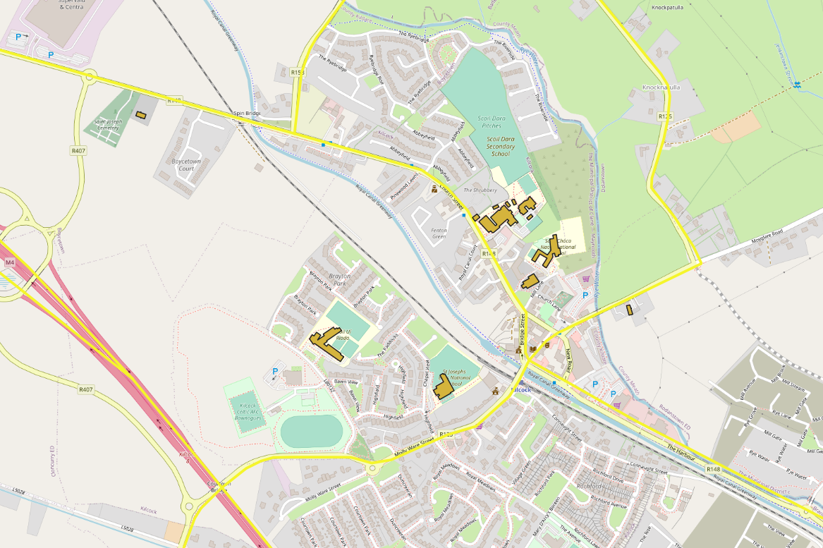
Churches & Schools

Slide 13
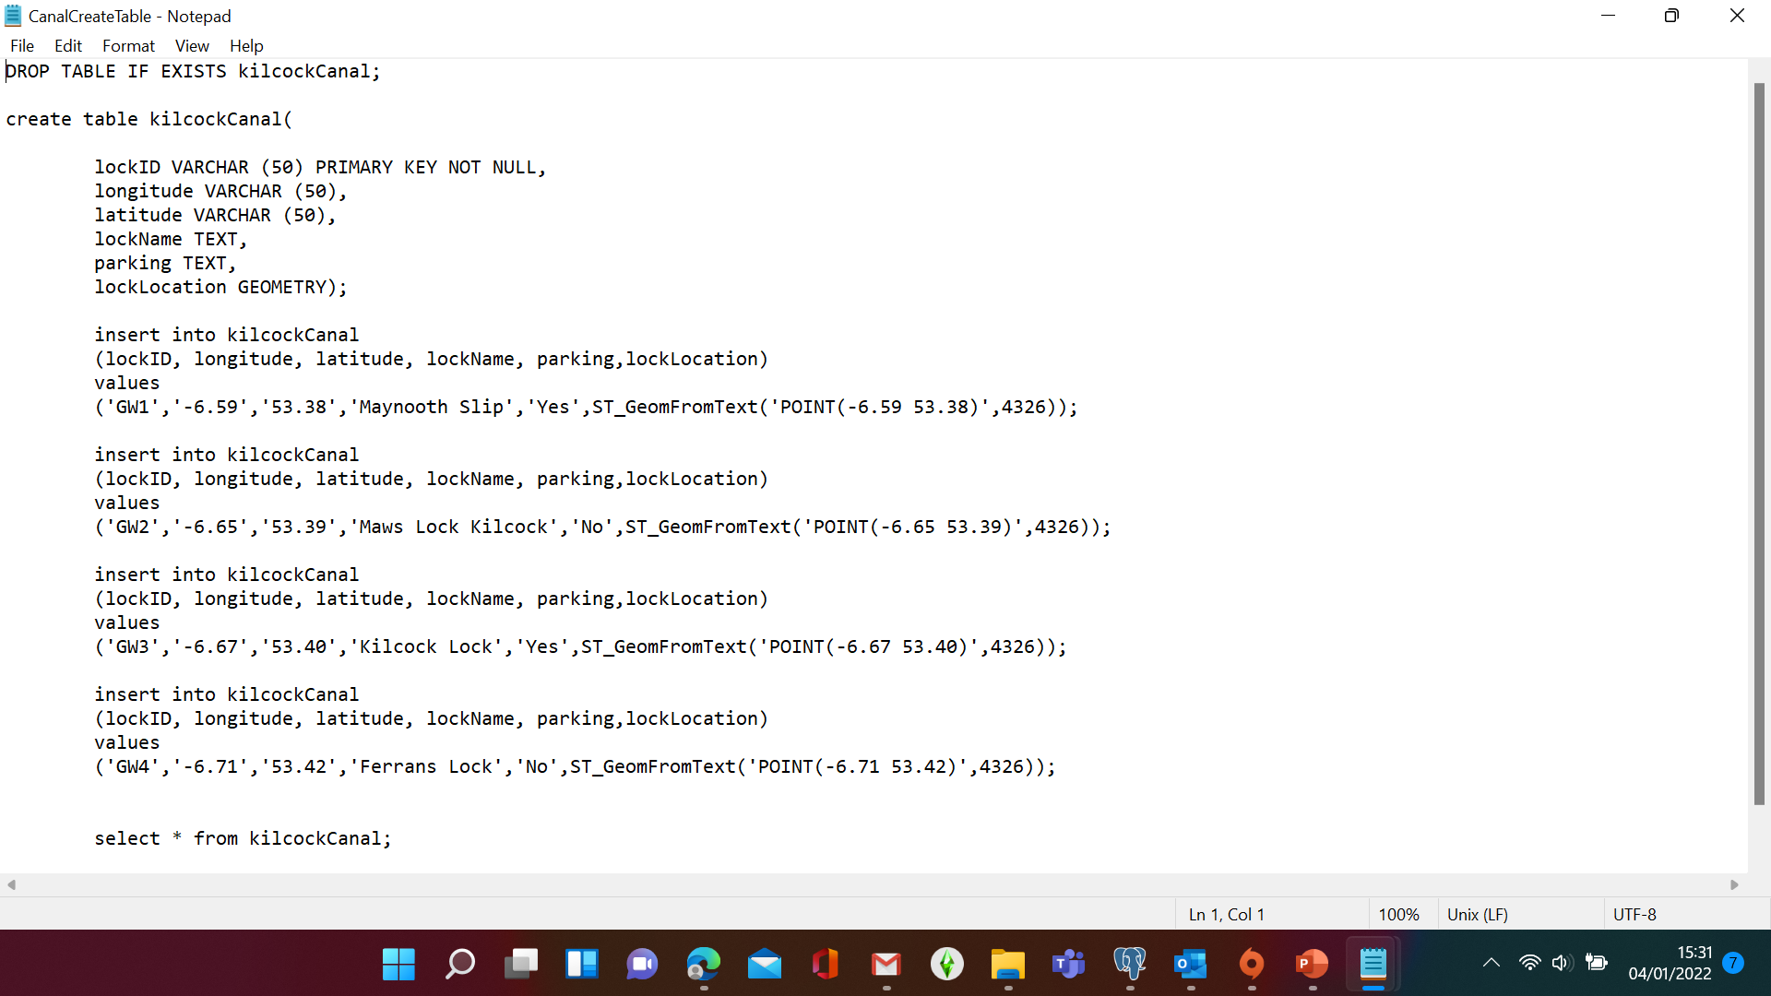
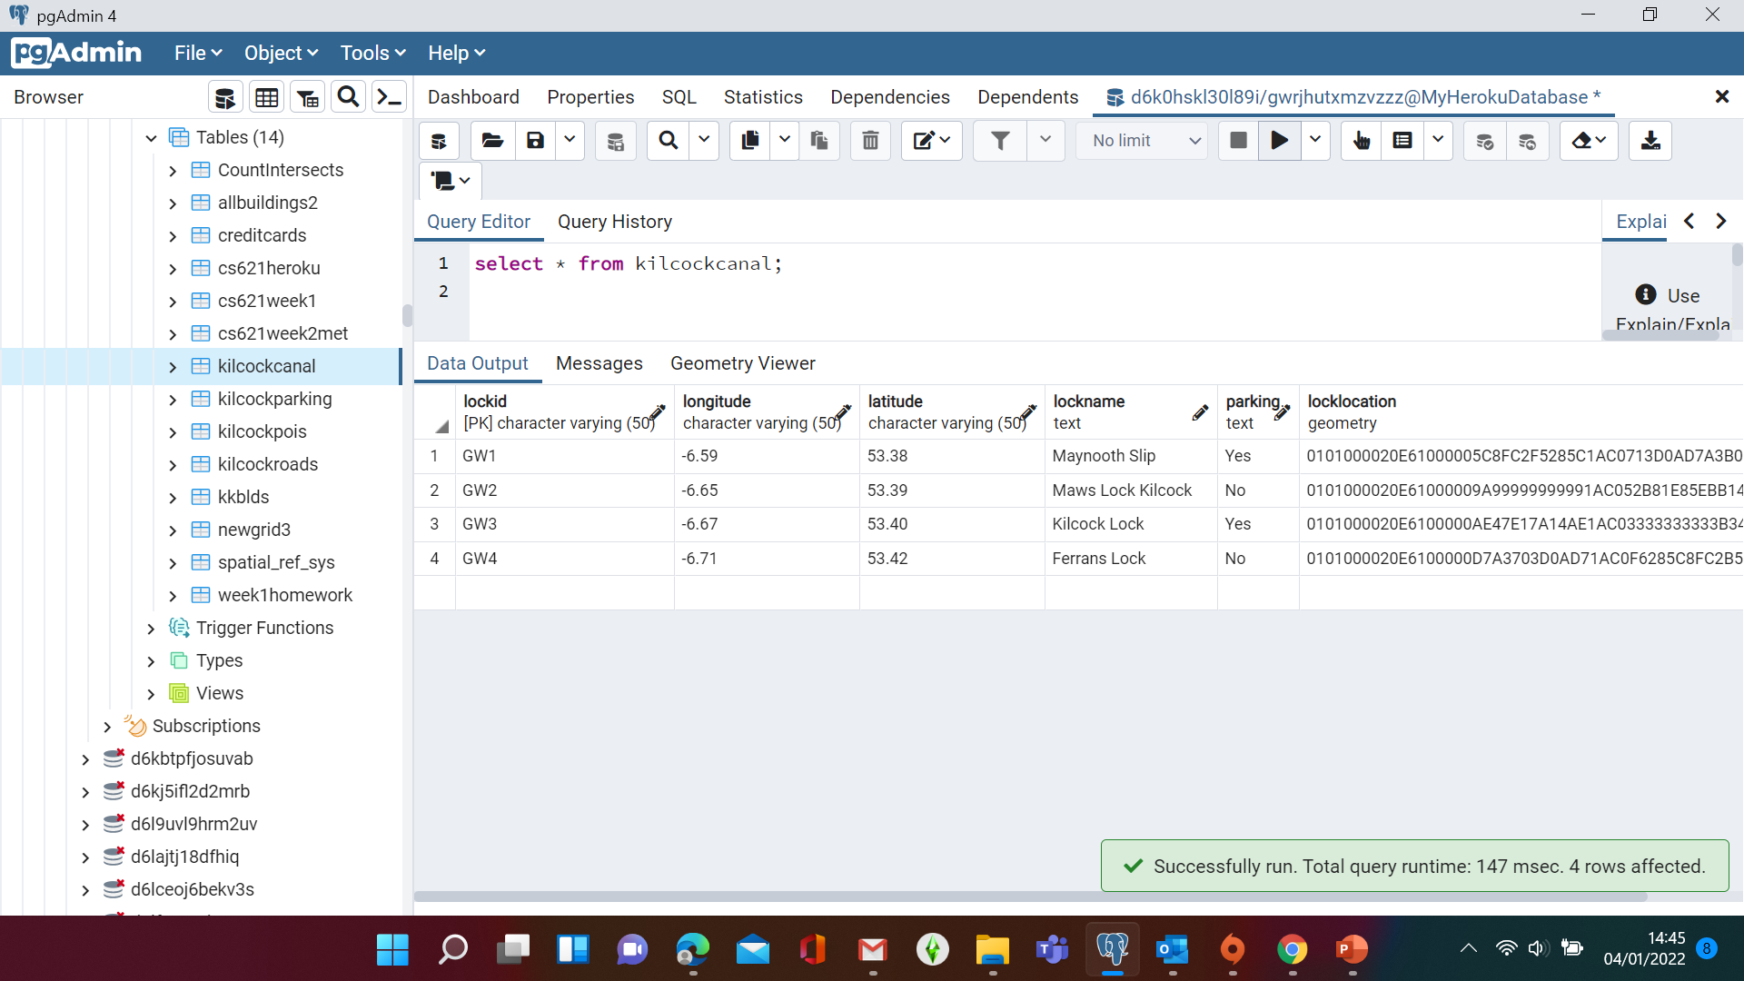
Canal Locks

Slide 14
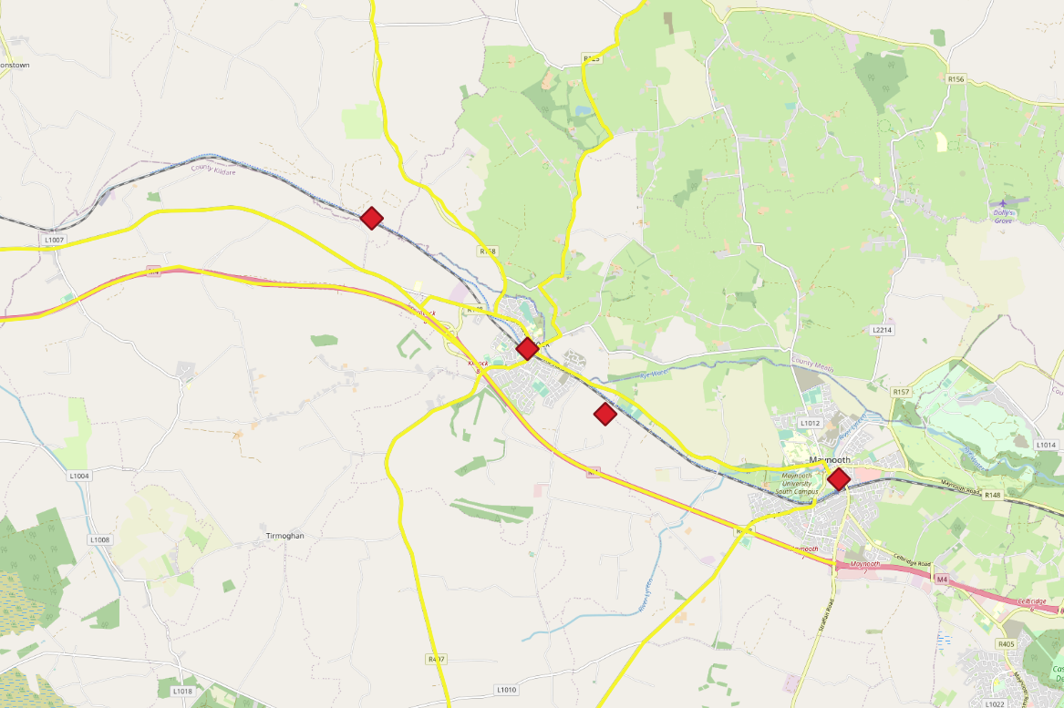
Canal Locks

Slide 15
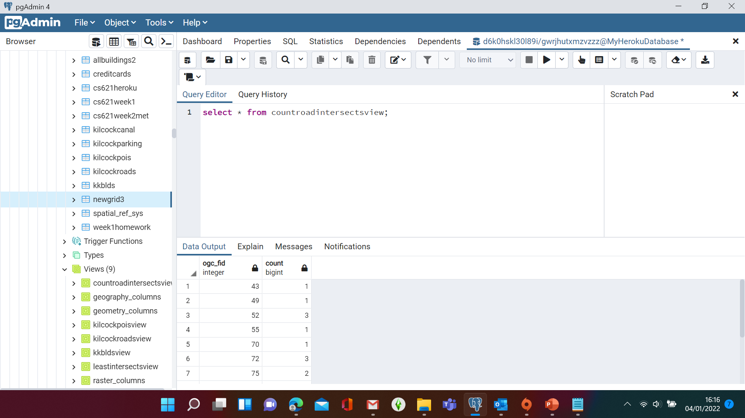
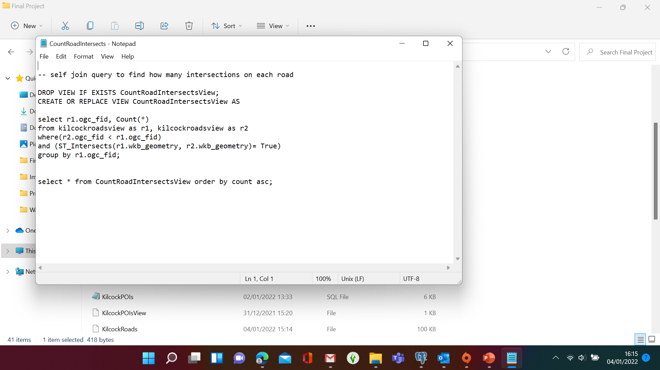
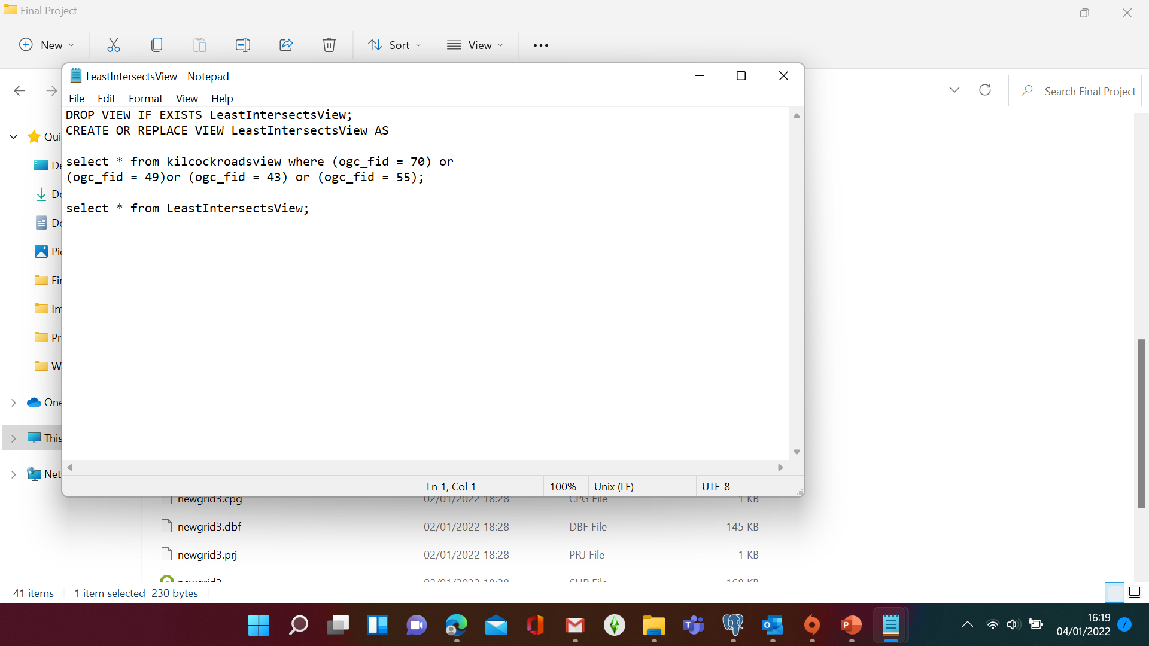
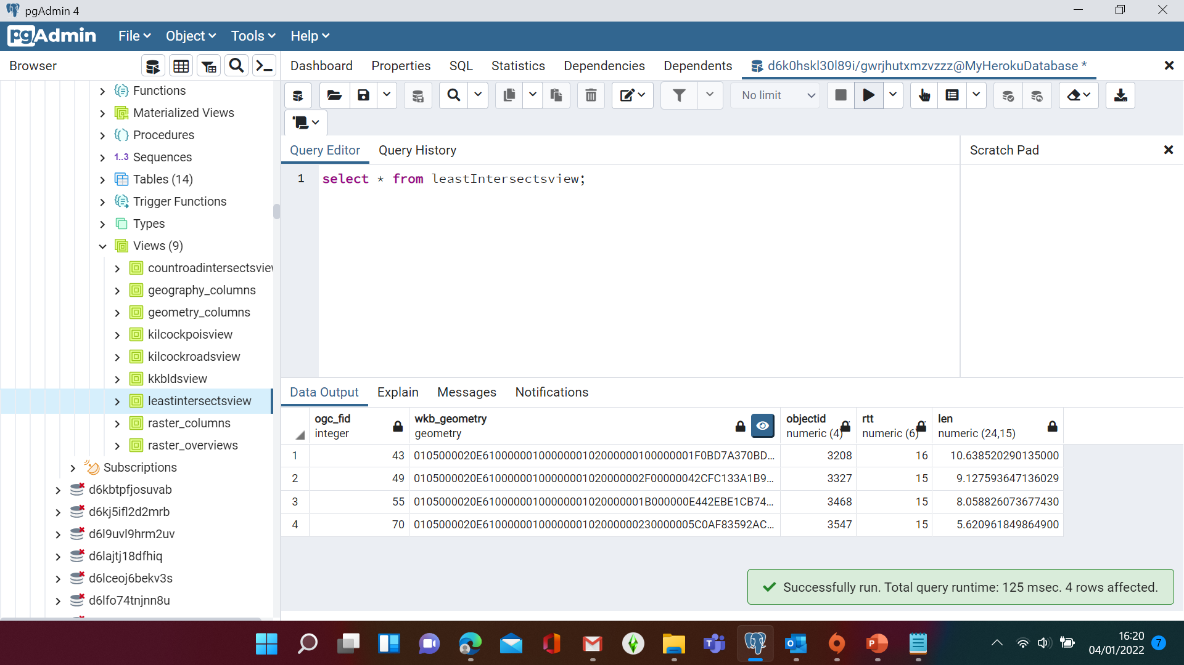
Road Intersections

Slide 16
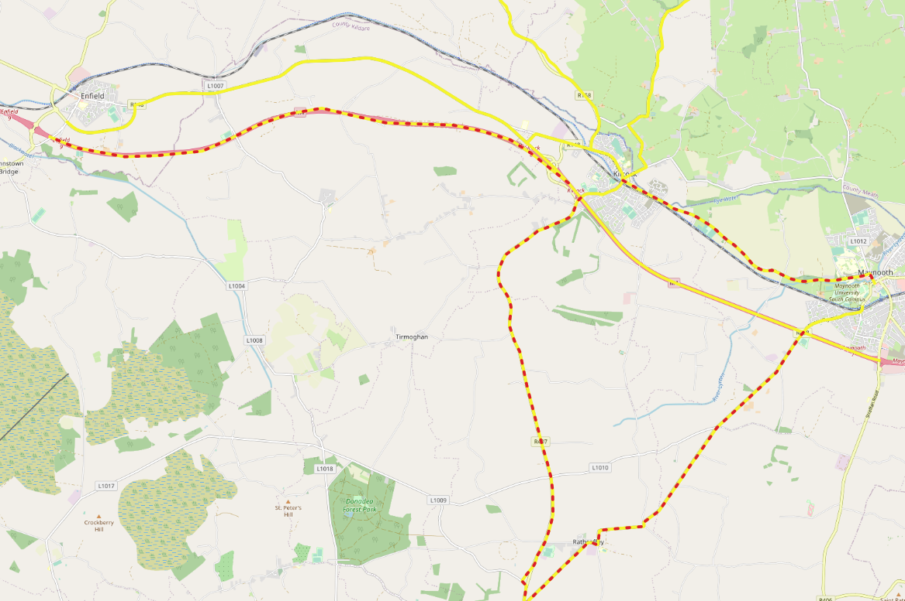
Roads with least number of major Intersections

Slide 17
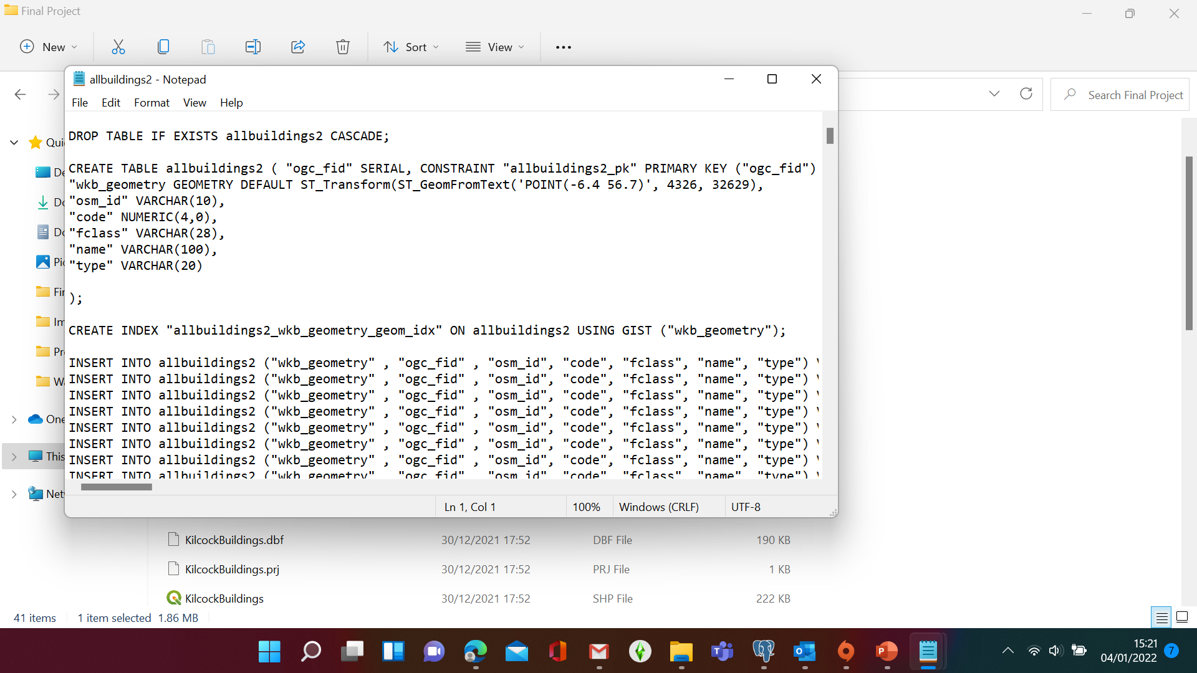
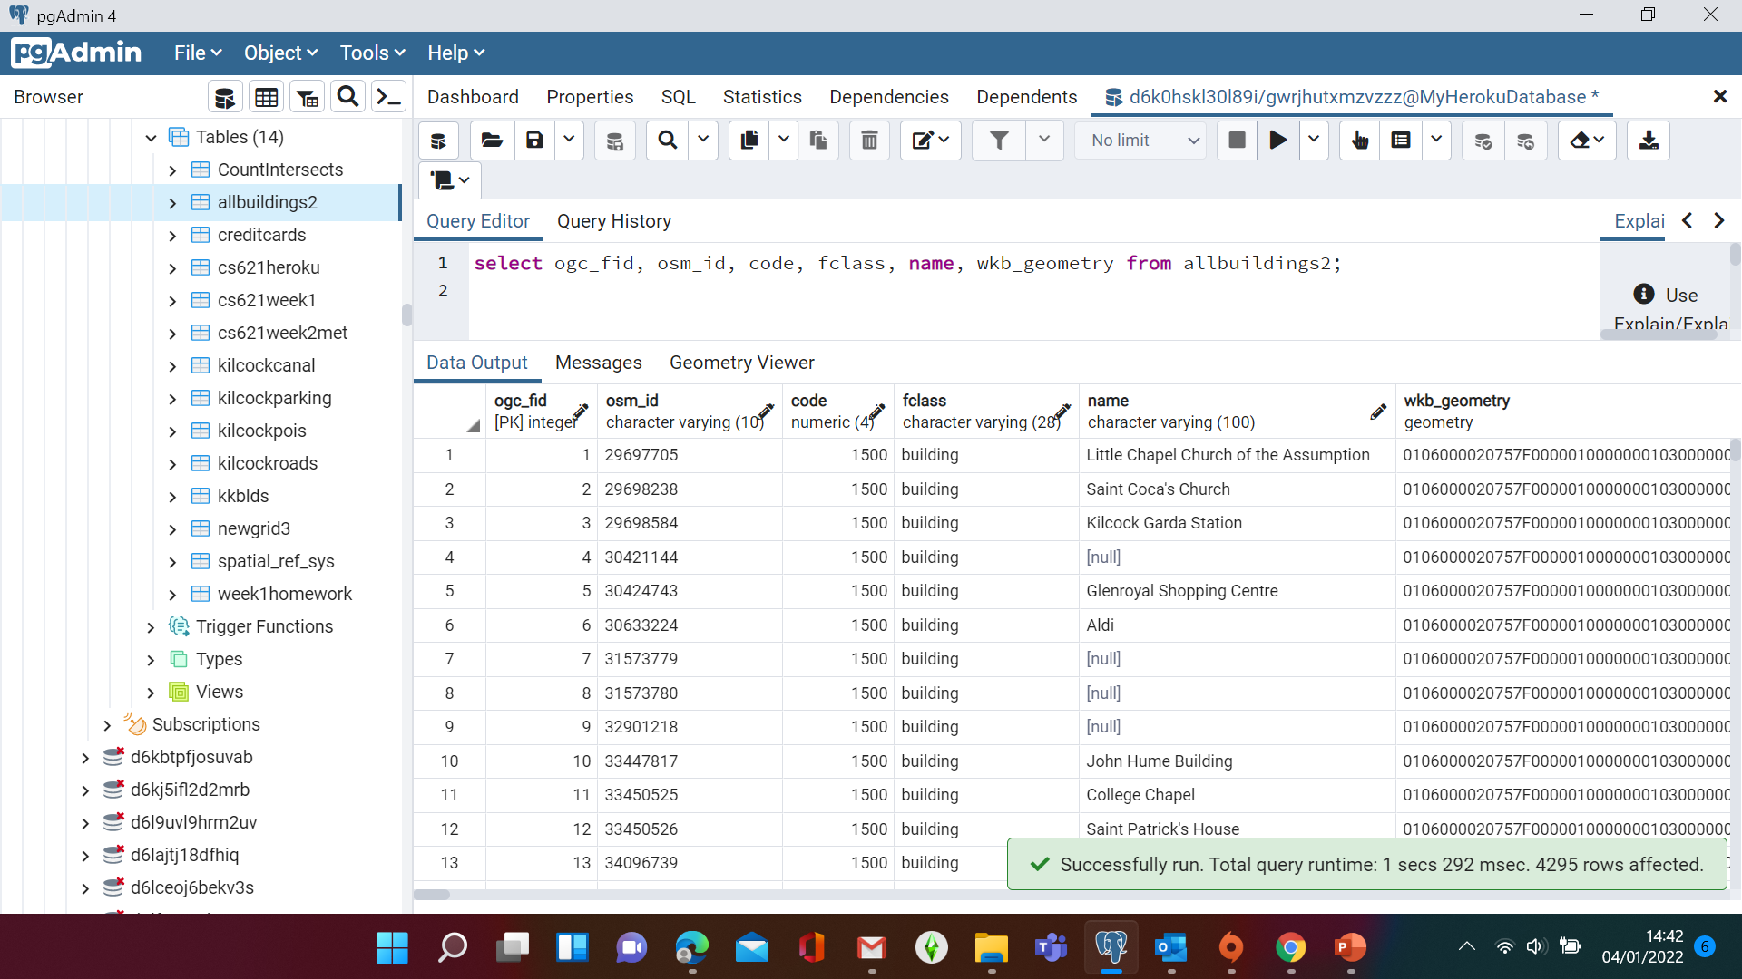
All Buildings within selected 5km Road area

Slide 18
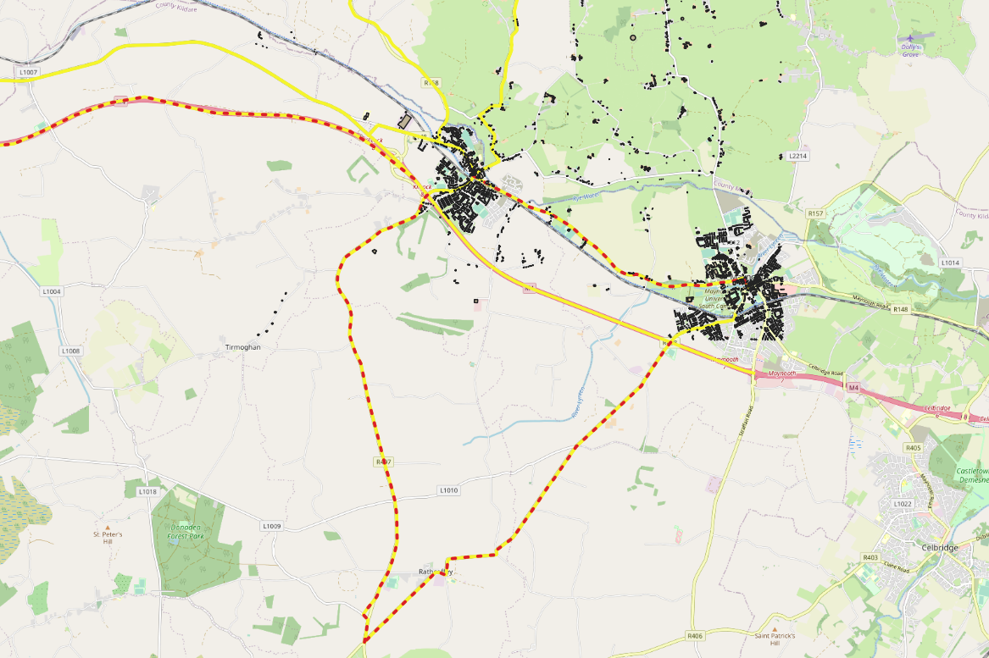
All Buildings within the 5km Road selection

Slide 19
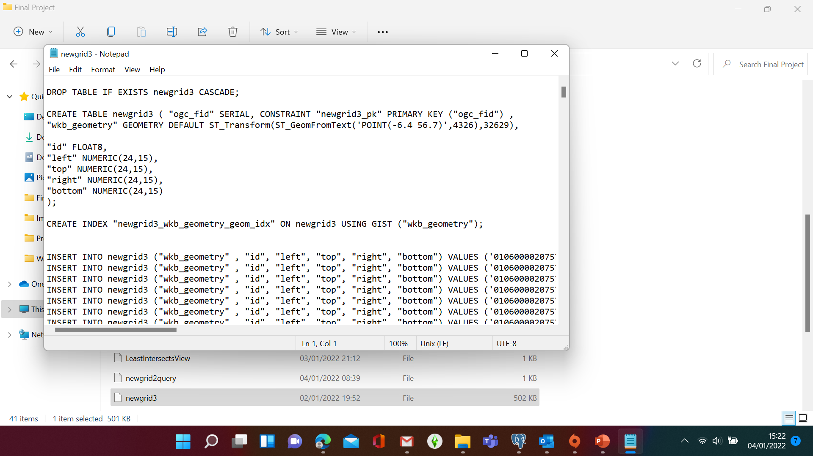
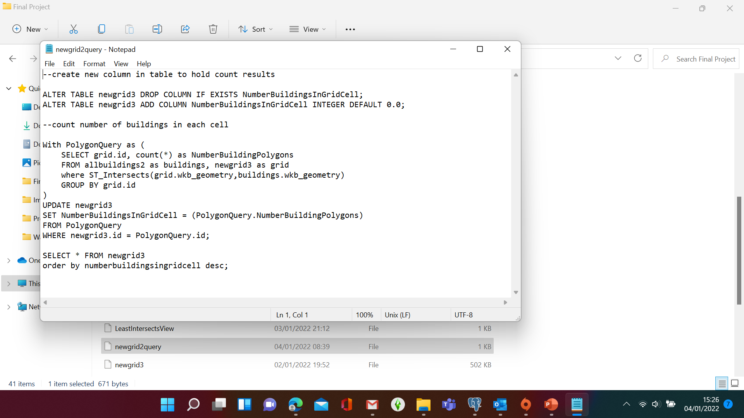
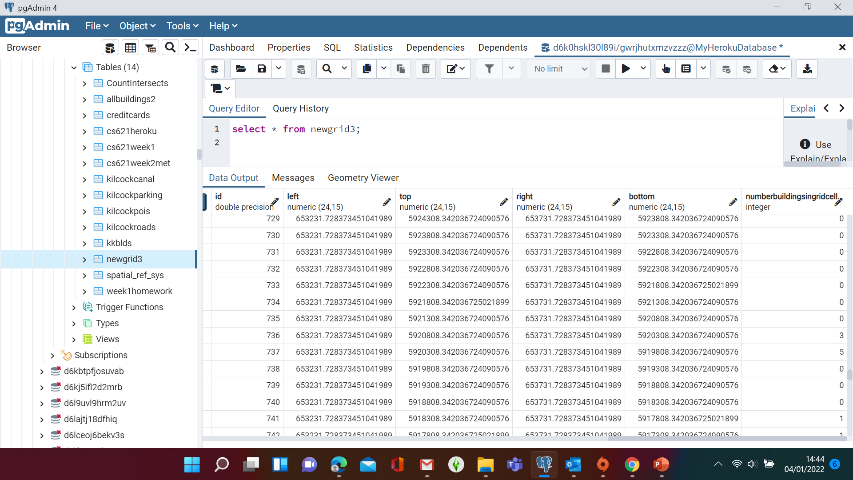
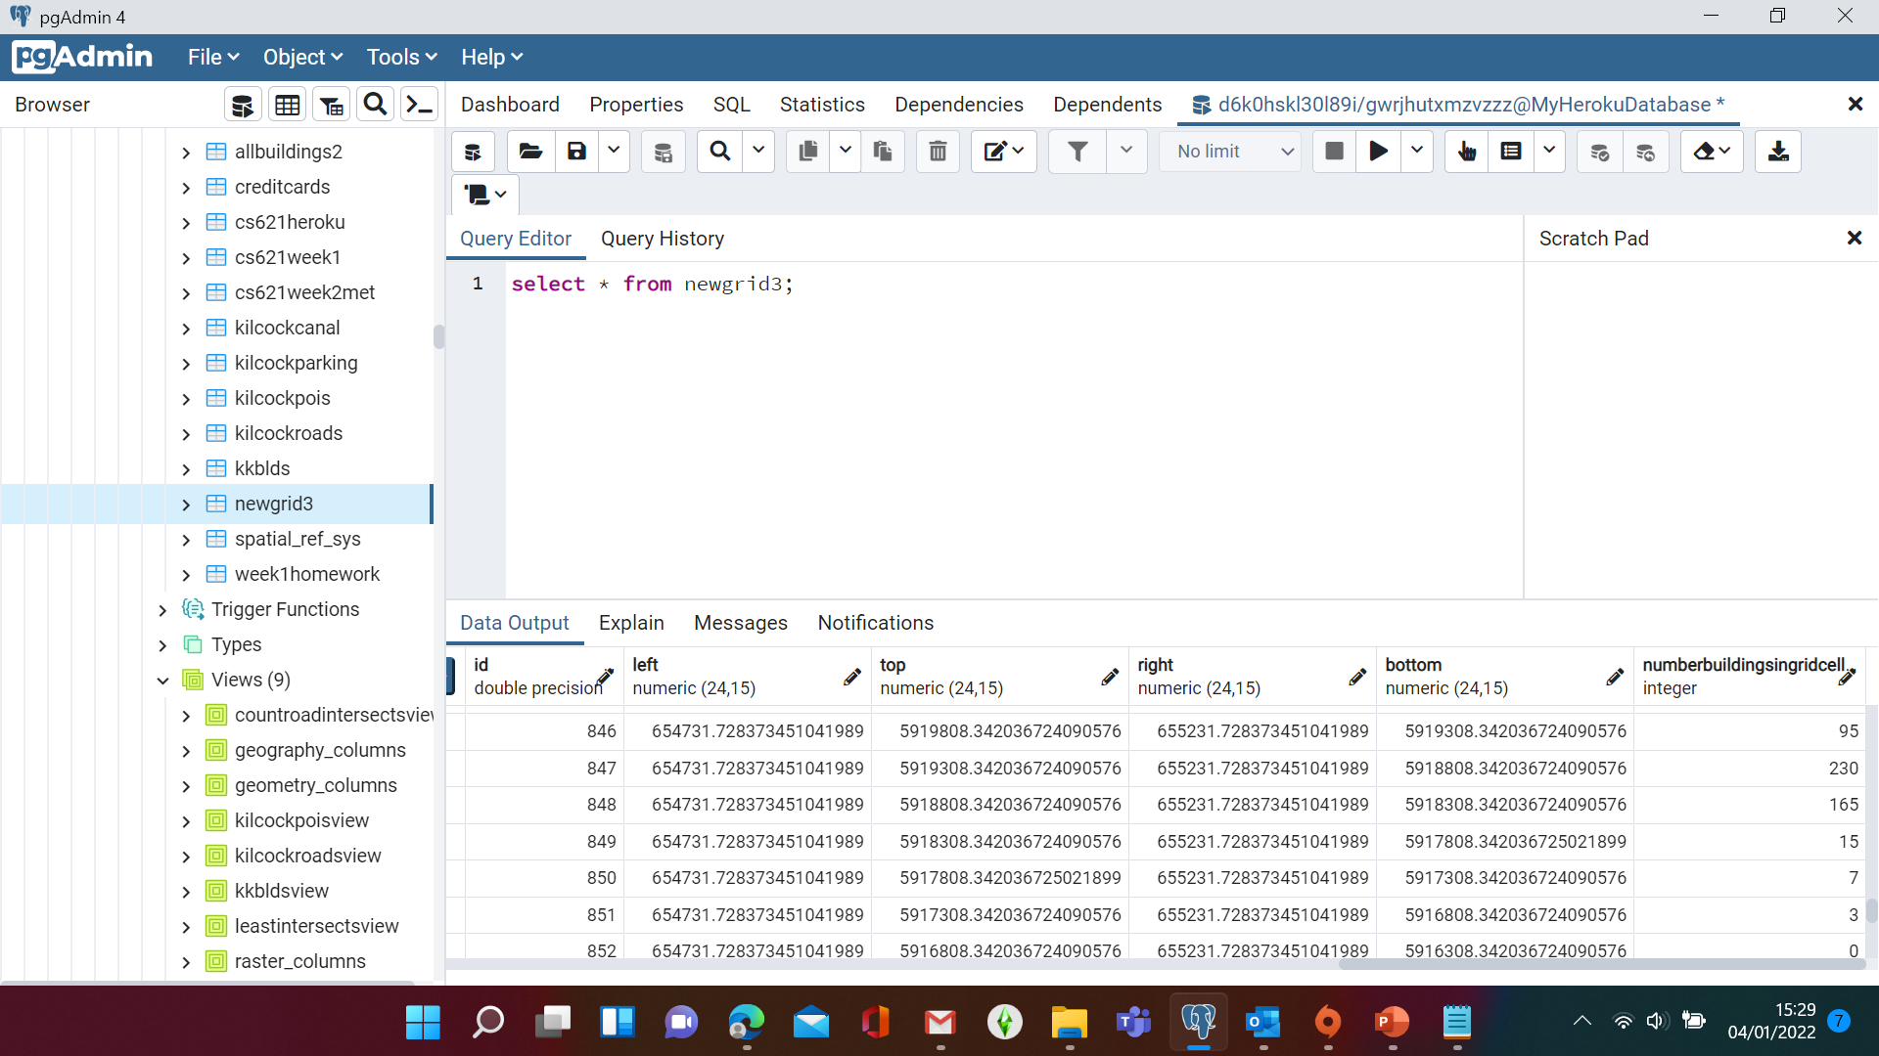
Buildings Vector Grid

Slide 20
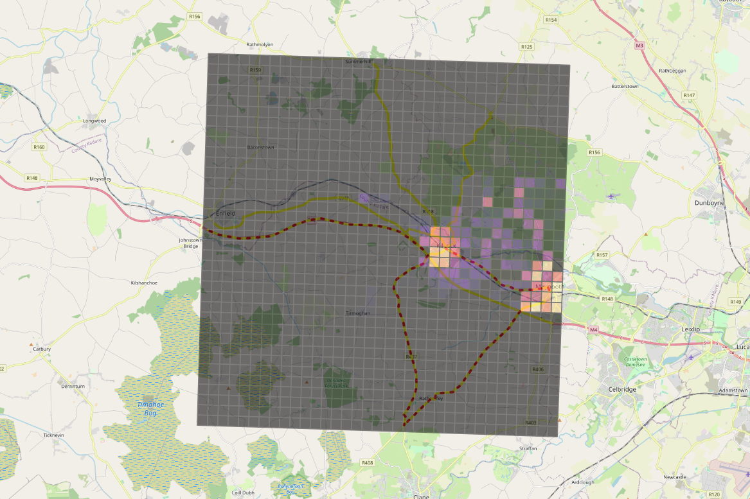
Buildings Vector Grid with Heat Map

Slide 21
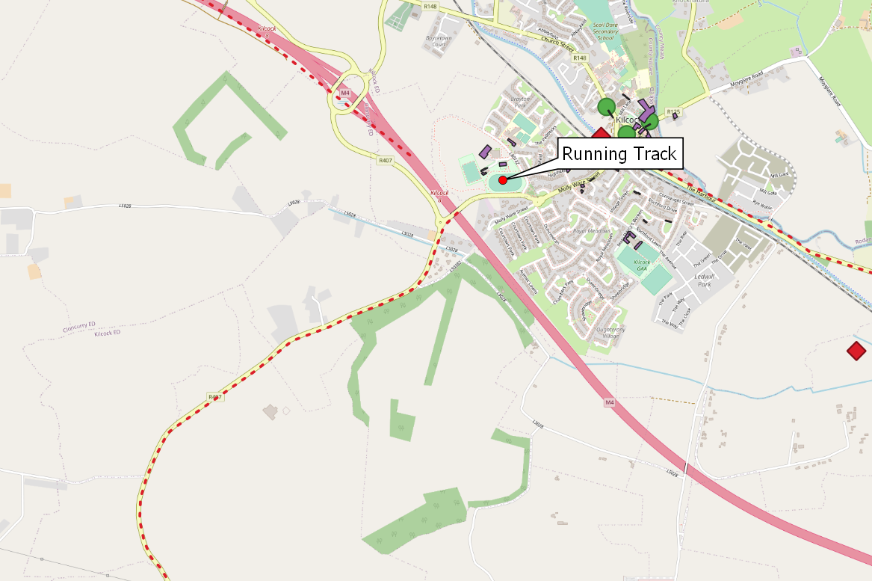
Summary

Slide 22
Thank you, I hope you enjoyed this presentation. Happy running!

